Slide 1
Money and Banking
Meaning of Money
Money Supply and Money Demand
Functions of Money
Banking
Commercial Banks
Functions of Commercial Bank
Money Creation or Credit Creation
Controller of Money Supply and Credit
Central Bank
Functions of Central Bank (Monetary Policy)

Slide 2
What is Money
Money is anything which is generally accepted as a medium of exchange, measure of value, store of value and means for standard deferred payment.
Functions:
Medium of exchange
Measure of value
Store of value
Standard deferred payment
Notes:
Money is a medium of exchange that facilitates the buying, selling, and trading of goods and services. It serves as a unit of account, a store of value, and a standard of deferred payment. Money can take various forms, including:
Currency: Physical forms of money, such as coins and banknotes, issued by the government and central banks.
Deposits: Funds held in bank accounts, including checking accounts, savings accounts, and certificates of deposit (CDs), which can be easily accessed and used for transactions.
Digital Money: Electronic or digital forms of money, including debit cards, credit cards, mobile wallets, and online payment platforms, which allow for electronic transactions and payments.

Slide 3
Money: Medium of Exchange
It can be used to make payments for all transactions of goods and services.
This function has removed the difficulty of lack of double coincidences of wants and inconveniences associated with the barter trade.
It allows purchase and sale to be conducted independently of one another.
Money has no power to satisfy human wants, but it commands power to purchase those things, which have utility to satisfy human wants.
Notes:
Money serves as a medium of exchange by facilitating transactions between buyers and sellers, allowing goods and services to be exchanged for a standardized form of currency. Here's an example:
Imagine you want to purchase a book from a bookstore. You have ₹500 in cash, and the book you want to buy is priced at ₹300. You visit the bookstore, select the book you want, and approach the cashier to make the purchase.
Using money as a medium of exchange, you hand over ₹300 to the cashier in exchange for the book. The cashier accepts the cash payment and provides you with the book in return. The transaction is completed smoothly, and both you and the bookseller benefit from the exchange:
You obtain the book you wanted in exchange for the money you paid.
The bookseller receives payment for the book sold and can use the cash to cover expenses, purchase inventory, or reinvest in the business.
In this example, money serves as a medium of exchange by facilitating the transaction between you (the buyer) and the bookstore (the seller). Without money as a medium of exchange, individuals would need to resort to bartering, which can be inefficient and impractical for conducting transactions, especially in a complex modern economy with a wide variety of goods and services.

Slide 4
Money: Measure of Value
Money as a measure of value means that money works as a common denomination, in which values of all goods and services are expressed.
Money helps in calculating relative prices of goods and services. Due to this reason, it is regarded as a ‘unit of account’. For instance, ‘ rupee’ is the unit of account of India
Notes:
Money serves as a measure of value by providing a common unit of account that allows individuals to express the value of goods and services in terms of a standardized monetary unit. Here's an example:
Suppose you are shopping for groceries at a supermarket and need to purchase various items such as bread, milk, eggs, and vegetables. Each item has a different price, expressed in the local currency (let's say rupees). As you select items from the shelves, you use the price tags to determine the value of each item in terms of rupees.
For instance:
A loaf of bread is priced at ₹50.
A carton of milk is priced at ₹80.
A dozen eggs is priced at ₹60.
A kilogram of vegetables is priced at ₹100.
Using money as a measure of value, you can compare the prices of different items and make decisions about which items to purchase based on their relative value. You can assess the affordability of each item by considering its price in relation to your budget and preferences.
For example, you may decide that the bread and milk are essential items that you need to purchase, while the eggs and vegetables are optional items that you can choose to buy depending on your budget constraints. By comparing the prices of these items in terms of rupees, you can make informed choices about how to allocate your money and prioritize your purchases based on their perceived value.

Slide 5
Money: Store of value
Money can be used to transfer the purchasing power from present to future. It is a way to store wealth.
Money is available in fractional denomination.
Money has the merit of general acceptability. So, it can be easily exchanged for goods at all times.
Saving in terms of money are much more secured than in terms of goods. How??
Notes:
Money serves as a store of value when it retains its purchasing power over time, allowing individuals to save wealth for future use. Here's an example:
Imagine you receive a bonus of ₹10,000 from your employer. Instead of immediately spending it, you decide to save it for a future expense, such as buying a new laptop or going on vacation. You deposit the ₹10,000 into a savings account at your bank.
Over the next few years, you periodically check your savings account balance and notice that it has increased due to interest payments from the bank. Despite inflation and changes in the economy, the ₹10,000 you saved continues to maintain its value and even grows over time.
When you eventually decide to make a significant purchase, such as buying a laptop for ₹30,000, you withdraw the funds from your savings account. Despite the passage of time, your ₹10,000 deposit has retained its value and can still be used to purchase goods and services at their current market prices.
In this example, money serves as a store of value because it allows you to save wealth over time without significant loss of purchasing power. By storing your wealth in the form of money (in this case, deposited in a savings account), you can preserve its value and use it for future consumption or investment purposes.
Let's consider a simple example to illustrate why saving in terms of money is generally considered more secure than saving in terms of goods:
Imagine you have rupees100 and you want to save it for emergency purpose. You have two options:
Saving in Money: You decide to keep the rupees100 in a savings account at a bank. The bank offers you a guarantee that your money will be safe and secure. Additionally, your savings are protected by deposit insurance provided by the government, which means even if the bank were to face financial difficulties, your money (up to a certain limit) would be reimbursed by the government.
Saving in Goods: Alternatively, you decide to use the rupees100 to buy a valuable item, let's say a piece of jewelry. You keep the jewelry at home, thinking it's a secure way to save your money.
Now, let's consider what could happen in each scenario:
Saving in Money: Your $100 is safe and secure in the bank. Even if there were to be a burglary at the bank, your money is insured, so you wouldn't lose it. You can access your savings whenever you need them by withdrawing from your account, and you don't have to worry about the value of your money decreasing over time.
Saving in Goods: Keeping the valuable item at home might seem secure initially. However, there's a risk of theft or damage to the item. If your home were to be burglarized or if the item were lost or damaged, you would lose the value of your savings. Additionally, the value of the jewelry may fluctuate over time, depending on factors like fashion trends, market demand, and the condition of the item.
In this example, saving in terms of money provides greater security and peace of mind compared to saving in terms of goods. Money held in a bank account is insured, easily accessible, and less susceptible to loss or damage, making it a more secure way to preserve and protect your savings.

Slide 6
Money: Standard Deferred Payment
As standard of deferred payment, money can be used in the settlement of debt and future payment.
Loans are advanced and future contracts are settled in terms of money.
In short, money can be used as a deferred payment when individuals or businesses agree to pay for goods or services at a later date, rather than immediately.
Notes:
Suppose you visit a furniture store and decide to purchase a new sofa for ₹20,000. However, you don't have enough cash on hand to pay for the sofa upfront. Instead, you negotiate with the furniture store owner to make a deferred payment arrangement.
The furniture store owner agrees to allow you to take the sofa home immediately, with the understanding that you will pay the full amount of ₹20,000 in two months' time. You both sign a contract outlining the terms of the deferred payment agreement, including the repayment schedule and any applicable interest charges.
As per the agreement, you take the sofa home and enjoy using it for the next two months. When the agreed-upon payment date arrives, you make a payment of ₹20,000 to the furniture store owner, settling the debt in full.
In this example, money is used as a deferred payment mechanism, allowing you to acquire the sofa immediately and pay for it at a later date. The deferred payment arrangement provides flexibility for both parties and enables you to make a large purchase without needing to have the full amount of cash upfront.
Imagine you own a small business that sells electronic gadgets. You want to import a shipment of smartphones from a manufacturer located in another country. The total cost of the shipment is $10,000.
Here's how money can be used as deferred payment in this scenario:
Negotiating Payment Terms: Before placing the order, you negotiate payment terms with the manufacturer. You agree to pay for the shipment within 30 days of receiving the goods, allowing you some time to sell the smartphones and generate revenue before making the payment.
Placing the Order: Once the payment terms are agreed upon, you place the order with the manufacturer. They prepare and ship the smartphones to your location.
Receiving the Goods: The shipment arrives at your warehouse, and you inspect the smartphones to ensure they meet the agreed specifications and quality standards.
Selling the Goods: Over the next few weeks, you sell the smartphones to customers through your retail store or online platform. As you sell the smartphones, you generate revenue from the sales.
Making the Payment: At the end of the 30-day period, you use the revenue generated from the sales to make the payment to the manufacturer. You transfer $10,000 to the manufacturer's bank account as per the agreed terms.
In this example, money is used as deferred payment for the imported goods. Instead of paying for the shipment upfront, you negotiate payment terms that allow you to receive the goods first and pay for them later. This arrangement gives you time to sell the goods and generate revenue before making the payment, helping to manage your cash flow and liquidity effectively.

Slide 7
Evolution of Money
Barter System
Commodity Money
Metallic Coinage
Representative Money
Fiat Money
Digital Money and Cryptocurrency
Notes:
The evolution of money can be traced through various stages, each representing a progression in the functions and forms of money. Here's an overview along with examples and limitations of each kind of money:
Barter System: In the earliest stage of human exchange, goods and services were directly traded without the use of money. For example, a farmer might exchange a bushel of wheat for a pair of shoes made by a cobbler.
Limitations:
Lack of Double Coincidence of Wants: Barter requires a coincidence of wants between traders, making it inefficient and cumbersome.
Lack of Divisibility: Some goods may not be easily divisible, leading to challenges in making precise exchanges.
2. Commodity Money: As societies evolved, certain goods with intrinsic value, such as gold, silver, or cattle, began to be used as money. These commodities were accepted as a medium of exchange based on their inherent worth.
Examples:
Gold coins minted by ancient civilizations.
Cattle used as currency in pastoral societies.
Limitations:
Inconvenient to Carry: Precious metals or livestock can be heavy and difficult to transport, posing challenges for large transactions or long-distance trade.
Limited Supply: The supply of commodity money is limited by nature, leading to issues of scarcity and potential hoarding.
3. Metallic coinage
The metallic coinage system of money involves the use of coins made from various metals, such as gold, silver, copper, and bronze, as a medium of exchange and store of value.
Susceptibility to Debasement: Some governments debased their coinage by reducing the precious metal content or adulterating it with cheaper metals. This led to a decline in the value of coins, inflationary pressures, and loss of confidence in the currency.
Storage and Security Concerns: Metallic coins needed to be securely stored to prevent theft or loss. While coins were more durable than perishable commodities, proper storage facilities were required to safeguard them from damage or theft.
Weight and Portability Issues: Metallic coins could be heavy and cumbersome to carry, especially for large transactions or long-distance trade. This posed challenges for portability and convenience in commerce.
4. Representative Money: To address the limitations of commodity money, representative money emerged. Instead of directly using commodities, certificates or tokens representing a claim to a specific quantity of a commodity were circulated as money.
Examples:
Gold certificates issued by banks, redeemable for a fixed amount of gold.
Banknotes backed by a reserve of gold or silver.
Limitations:
Risk of Counterfeiting: Representative money is susceptible to counterfeiting, leading to concerns about trust and authenticity.
Dependency on Issuer: The value of representative money depends on the issuer's ability to redeem it for the underlying commodity, raising concerns about solvency and reliability.
5. Fiat Money: Modern monetary systems are based on fiat money, which has value because a government declares it to be legal tender and accepts it for payment of taxes and other debts.
Examples:
Paper currency issued by central banks, such as the US dollar or the euro.
Digital currency issued by governments or central banks, such as digital versions of national currencies.
Limitations:
Vulnerability to Inflation: Fiat money is susceptible to inflationary pressures due to factors such as excessive money printing or loss of confidence in the currency.
Dependency on Government Stability: The value of fiat money is tied to the stability and credibility of the issuing government, raising concerns about political and economic stability.
Overall, the evolution of money reflects the need for increasingly efficient and reliable means of facilitating exchange and storing value. Each form of money has its advantages and limitations, and the transition from one form to another has been driven by technological advancements, economic developments, and changes in societal needs and preferences.
6. Digital Money
Digital money refers to any form of currency that exists purely in electronic or digital form. It is typically represented and transacted electronically, often through digital banking systems, payment platforms, or electronic transfers. Cryptocurrency is a type of digital or virtual currency that uses cryptographic techniques to secure financial transactions, control the creation of new units, and verify the transfer of assets. Unlike traditional currencies, cryptocurrencies operate on decentralized networks based on blockchain technology, which enables peer-to-peer transactions without the need for intermediaries like banks or governments.

Slide 8
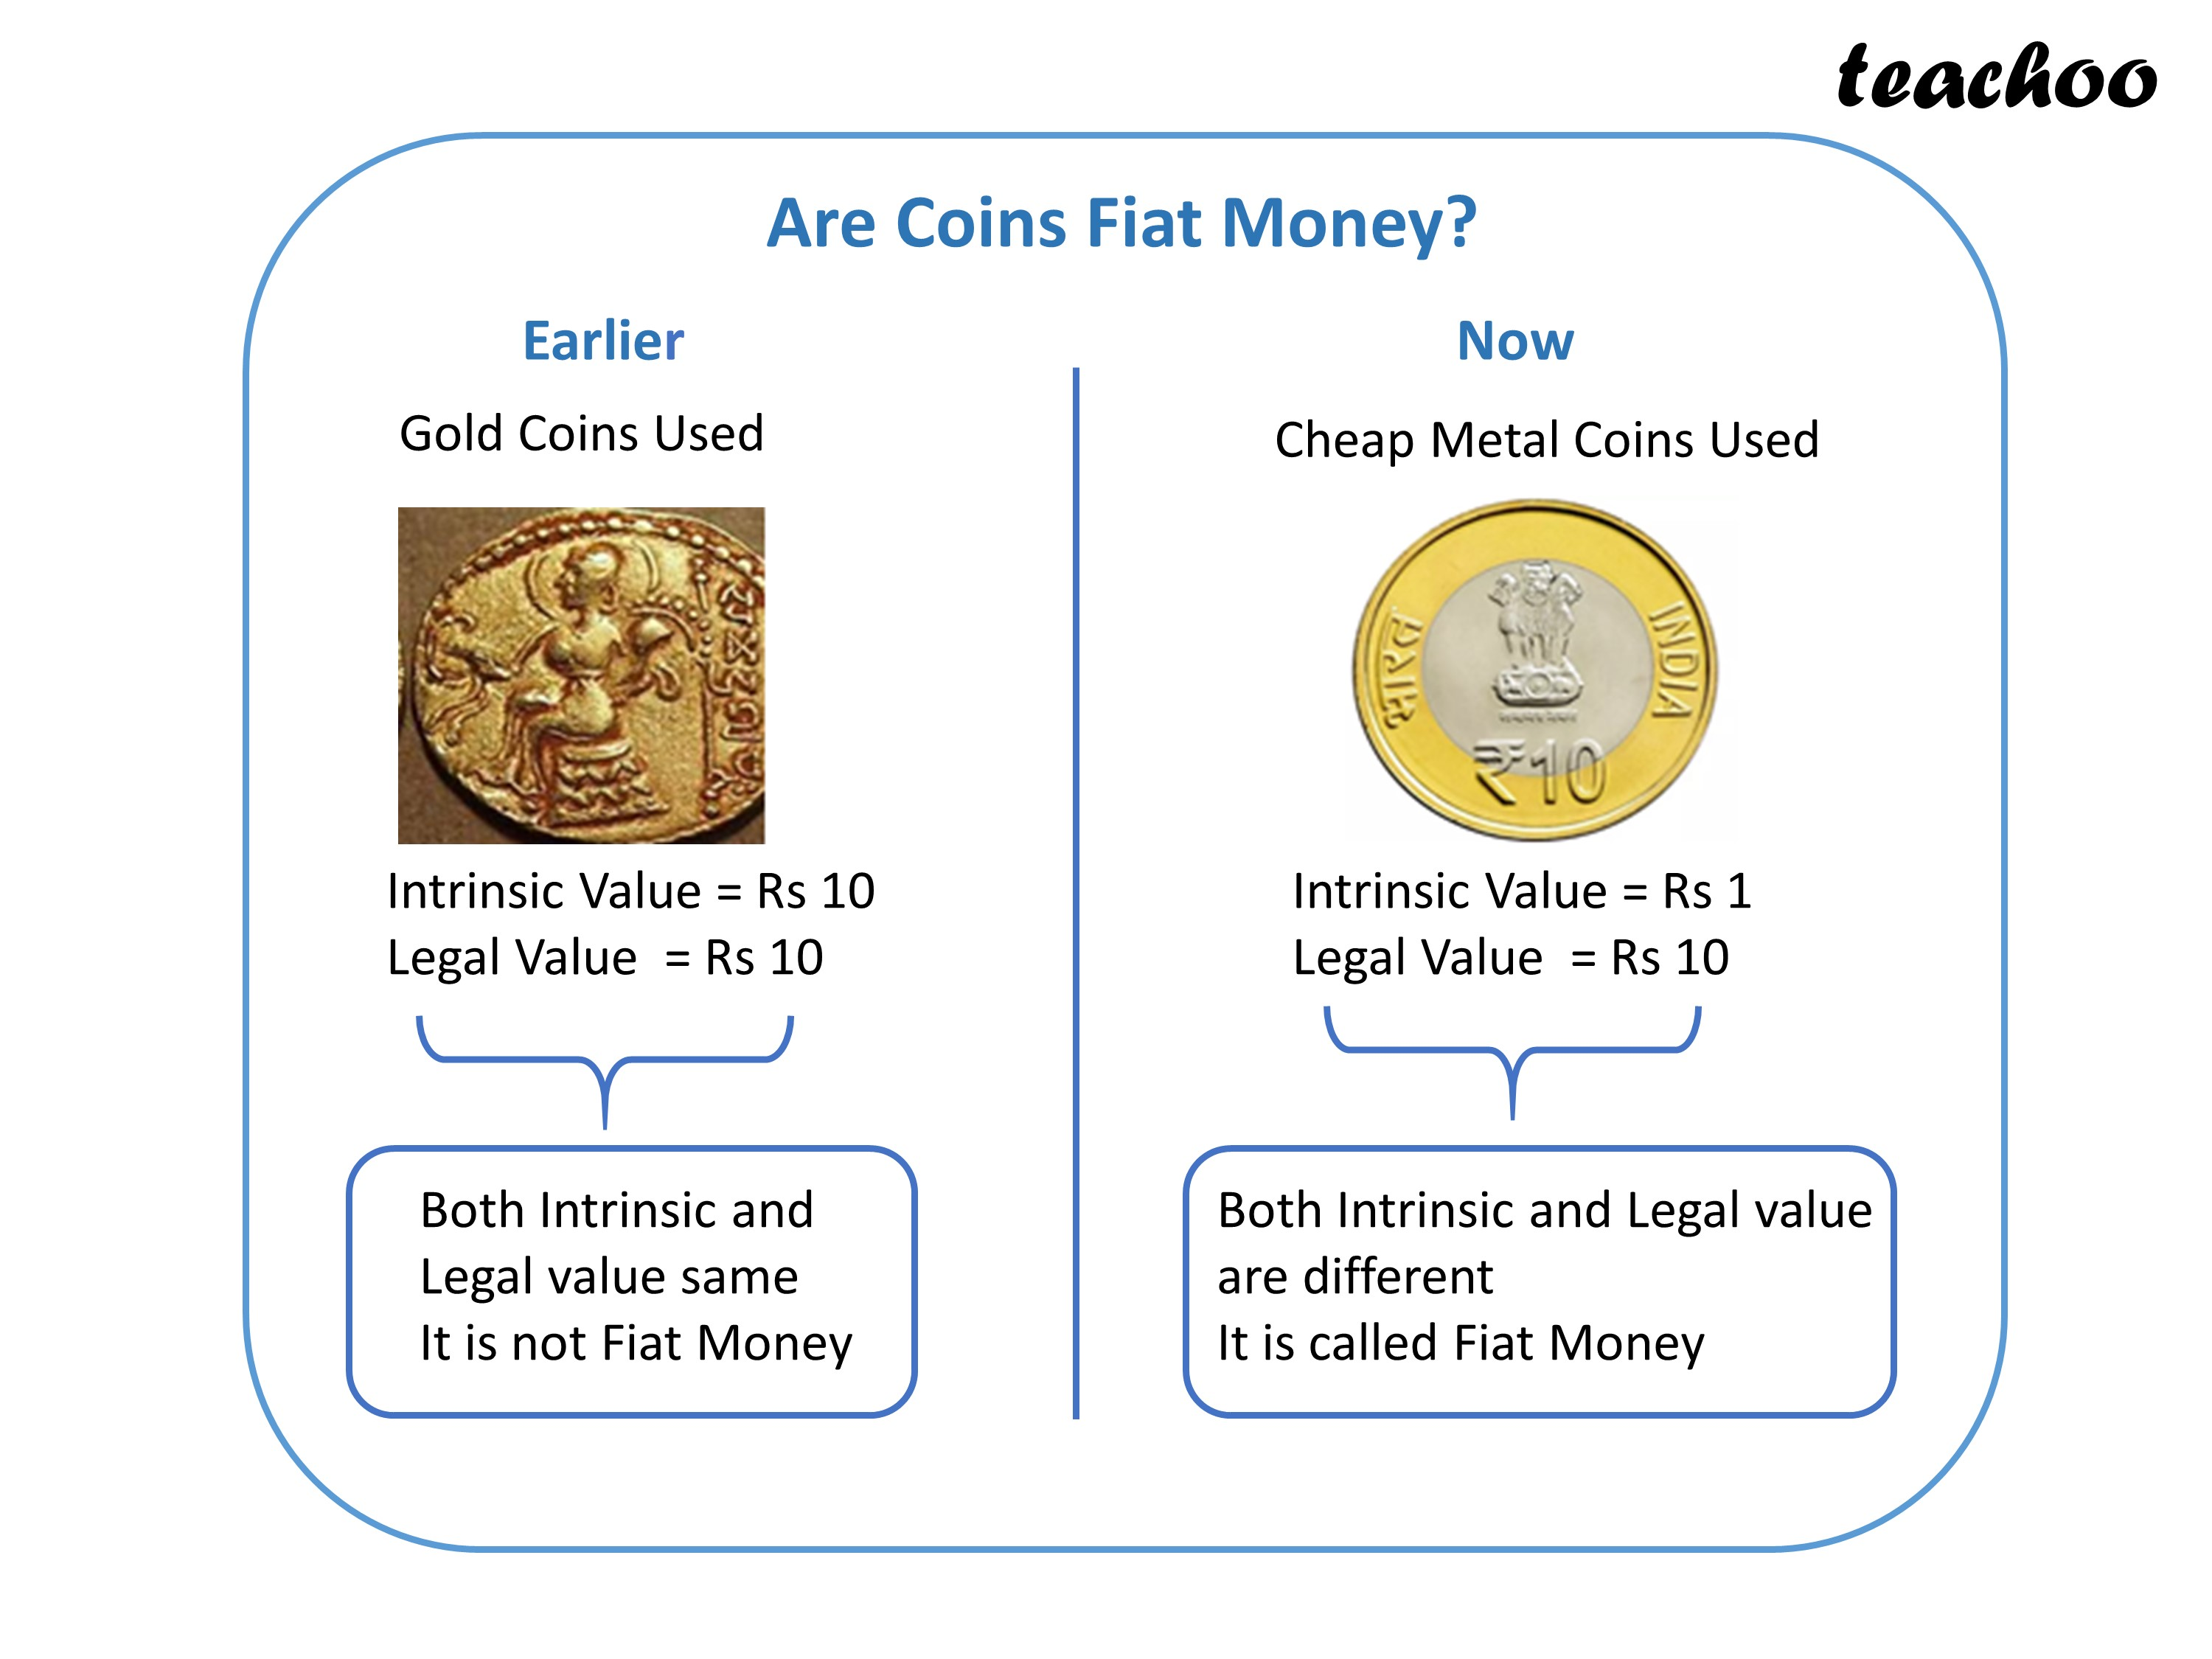
Notes:
Fiat money is currency that has value because a government says it does; it's not backed by a physical commodity like gold or silver. Coins can be fiat money if they are issued by a government and declared as legal tender, meaning they are accepted as a medium of exchange. In many cases, coins are fiat money because their value is determined by government decree rather than the value of the material they are made from. For example, modern coins are typically made from inexpensive metals like copper, nickel, or zinc, yet their value is much higher than the intrinsic value of the metal due to their status as legal tender. So, in short, yes, coins can be fiat money.

Slide 9
Demand for Money
The demand for money is the total amount of money that the population of an economy wants to hold.
There are three main motives, for which money is wanted by the people:
Transactionary Demand
Precautionary Demand
Speculative Demand
Notes:
The demand for money explains the desire of people for a definite amount of money. Money is needed to manage transactions, and the value of transactions decides the money people want to keep.
The larger the quantum of transactions, the bigger is the amount of money demanded. Since the quantum of transactions relies upon earning, it should be lucid that a rise in income leads to a rise in the demand for money.
When people stockpile their savings in the form of money rather than keeping it in a bank that fetches them interest, the money people stockpile also relies upon the rate of interest.
Particularly, when interest rates rise, people become less focused on stockpiling money since holding money leads to holding less of interest-earning deposits. Thus, they receive less interest. Hence, the money demanded decreases at high interest rates.
The demand for money is the total amount of money that the population of an economy wants to hold.
The three main reasons to hold money, as opposed to bonds, equity, or other financial asset classes, are as follows:
A transactions-related reason – People need money on a regular basis to pay bills and finance their discretionary consumption;
A precautionary reason, as an unexpected need, can often arise; and
A speculative reason if they expect the value of such money to increase versus other asset classes.

Slide 10
Demand for Money: Transaction Motive
It refers to demand for money for conducting day-to-day transactions.
The transaction motive relates to demand to meet the current transactions of individuals and business units.
The income, which a person gets, is not continuous whereas, expenditure is continuous. Therefore, to bridge the gap between the receipt of income and it’s expenditure, people hold cash
Notes:
Transaction demand for money refers to the need individuals and businesses have for money to carry out day-to-day transactions. It represents the demand for money as a medium of exchange to facilitate the buying and selling of goods and services in the economy. Several factors influence transaction demand for money:
Level of Economic Activity: Higher levels of economic activity typically lead to increased transactions, requiring more money to facilitate exchanges.
Price Level: As prices rise, more money is needed to make purchases, leading to an increase in transaction demand for money.
Payment Patterns: The frequency and size of transactions influence the amount of money people hold for transactions. For example, businesses may hold larger cash balances to meet payroll obligations.
Technology and Payment Methods: Technological advancements, such as online banking and electronic payments, have altered payment patterns but have not eliminated the need for physical cash entirely.
Banking System Efficiency: The efficiency of the banking system affects transaction demand. A well-functioning banking system can reduce the need for individuals to hold large cash balances.
Overall, transaction demand for money represents the portion of money demand that arises from the need to facilitate transactions in the economy. It is an essential determinant of the overall demand for money and plays a crucial role in monetary policy formulation and implementation. Central banks often monitor transaction demand for money closely to ensure that the money supply aligns with the needs of the economy.

Slide 11
Demand for Money: Precautionary Motive
It refers tot the desire of people to hold cash balances for unforeseen contingencies.
People wish to hols some money to provide for the risk of unforeseen events like sickness, accident, etc.
It is closely related to the level of income. Higher the level of income, more will be the cash balances for contingencies.
Notes:
Precautionary money balances are held to moderate the impact of unexpected spending needs that can occur in the future. The factors that drive the demand for precautionary money balances are similar to those analyzed for transaction money balances.
As the level of economic activity and GDP rises, companies and consumers will increase the level of precautionary money balances for unforeseen spending needs.
The availability of credit and the level of interest rates affect the level of precautionary money balances. Other conditions held equal, when credit is easily (hardly) available and interest rates are low (high), such money balances are expected to rise (decline).
The balances held for precautionary reasons must be consistent with the level of spending of a company, family, or individual. For example, a precautionary balance of rupees 500 would not be enough for a family that is spending rupees 5,000 per month.

Slide 12
Demand for Money: Speculative Motive
Speculative demand for money refers to the desire of individuals to hold money as a store of value or as an investment asset, with the expectation that its value will increase in the future.
It is all about how much money people choose to hold onto because they're uncertain about future investment opportunities or because they think there might be better options down the road.
It's like trying to decide whether to spend your money now or wait and see if you can get a better deal later.
Notes:
Money held for speculative reasons is also known as the portfolio demand for money. The money is held to take advantage of speculative opportunities or for covering/offsetting risks in other assets or the economy. There are several cases in which money is used as a speculative instrument:
Real Estate Example: if you're considering buying a house or property, you might be speculating on the future value of real estate. If you think property prices will rise in the future, you might be more inclined to invest your money in real estate now. But if you're uncertain about the housing market's future direction, you might hold onto your money and wait for more clarity before making a decision.
Bank Account Example: Even just keeping your money in a savings account involves a form of speculative demand. You might choose to keep more money in your bank account if you're unsure about other investment options or if you think there might be better opportunities to invest in the future. On the other hand, if you're confident in your investment choices or if you think interest rates might go up soon, you might be more inclined to invest your money elsewhere.

Slide 13
Money Supply
It refers to the total volume of money held by public at a particular point of time.
Money Supply can be defined as the money circulating in an economy.
As money supply is connected with ‘circulating money’, only the highly-liquid forms of money like currency and bank deposits are usually considered.
Notes:
It is a stock concept. It is concerned with a particular point of time. Stock and flow are concepts used in economics to differentiate between variables that represent quantities at specific points in time (stock) and variables that represent quantities over a period of time (flow).
Here's a breakdown of the difference between stock and flow with an example:
Stock:
Definition: A stock variable represents a quantity that exists at a specific point in time. It measures the amount of a particular resource, asset, or factor of production that is accumulated or stored up to a certain point in time.
Example: The total amount of money in a bank account is a stock variable. It represents the balance of funds held in the account at a specific moment in time. For instance, if John has rupees 1,000 in his bank account as of today, that rupees 1,000 represents the stock of money he currently possesses in his account. It's like taking a snapshot of the amount of money he has right now.
Flow:
Definition: A flow variable represents a quantity that occurs over a period of time. It measures the rate of change or movement of a particular resource, asset, or factor of production over a specific time interval.
Example: The income John earns from his job is a flow variable. It represents the amount of money John earns over a specific period, such as a month or a year. For instance, if John earns rupees 30,000 per month from his job, that rupees 30,000 represents the flow of income he receives every month. It's like tracking the amount of money he earns over time.
The money supply is the total stock of money circulating in an economy. In the most simple language, Money Supply is Currency in Circulation plus Deposits in Commercial Banks.
Money supply consists of:
total currency circulating in the public plus
the non-bank deposits with a commercial bank.
Money supply includes deposits generated in the banking system resulting from a multiplier effect of movement of currency in the banking system as well as other forms of liquid assets.
What is meant by ‘currency in circulation’?
It is the total value of the currency (coins and paper currency) that has ever been issued by the Reserve Bank of India minus the amount that has been withdrawn by it.
Currency in circulation (currency with the public) comprises of:
currency notes and coins with the public
cash in hand with banks.
It is a major liability component of a central bank’s balance sheet.
However, if "government money" refers to funds held by the government itself, such as its reserves or accounts with the central bank, then these are typically not considered part of the broader money supply. This is because such funds are not generally available for use in transactions by households and businesses; they are more like assets held by the government rather than circulating in the economy as a medium of exchange.
The money supply is the total amount of money(currency+deposit money) present in an economy at a particular point in time. The standard measures to define money usually include currency in circulation and demand deposits.
The record of the total money supply is kept by the Central Bank of the country. The change in the supply of money in an economy can affect the price level of securities, inflation, rates of exchange, business policies, etc.

Slide 14
High-Power Money
Reserve money is also called central bank money, monetary base, base money, or high-powered money. It is the base level for the money supply or the high-powered component of the money supply.
High Power Money (Reserve Money or Base Money) – High power money is the base of money supply expansion in the economy.
High Power Money = C + OD + CR.
C = Currency in circulation OD = Other Deposits with the RBI (insignificant) CR = Cash Reserves of banks which consists of (i.) Cash with banks themselves and (ii) Bankers deposits with RBI.
Notes:
High power money or Reserve money or base money is the central bank issued money that function as the monetary base of an economy and it mostly includes all of the currency (currency notes, coin and e₹) in circulation, in addition to bank’s deposits with the central bank. It depicts the stock of monetary liabilities in the central bank’s balance sheet. The term "high-powered" in "high-powered money" does not necessarily imply that this form of money has a higher value or purchasing power compared to other forms of money. Instead, it refers to the unique characteristics of base money that make it influential in determining the overall money supply and liquidity in the economy.
The term "high-powered money" is often used because base money serves as the foundation or "base" upon which the broader money supply is built through the process of fractional reserve banking. Commercial banks create additional money supply through the process of credit creation, whereby they make loans and create new deposits in the process. The amount of money that can be created by commercial banks through lending and deposit creation is determined by the reserve requirement set by the central bank.
Base money is referred to as "high-powered" because changes in the monetary base can have a multiplier effect on the broader money supply. When the central bank adjusts the monetary base through open market operations (buying or selling government securities), changes in base money can lead to proportionate changes in the broader money supply as banks adjust their lending and deposit creation activities accordingly. This phenomenon is often described as the money multiplier effect, where changes in base money have a magnified impact on the overall money supply in the economy.
In summary, "high-powered money" is called "high-powered" because it serves as the base upon which the broader money supply is built and because changes in the monetary base can have a multiplier effect on the overall money supply and liquidity in the economy.

Slide 15
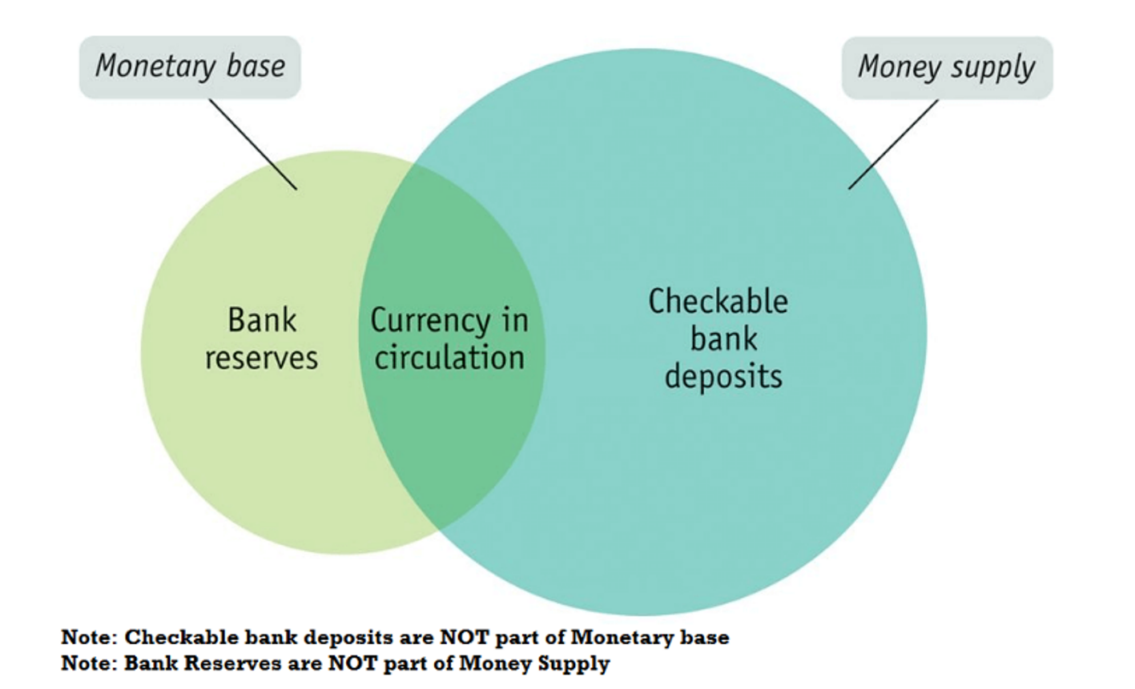
Monetary Base (M0) vs Money Supply (M1)
Notes:
The monetary base, also known as high-powered money or the monetary base, refers to the total amount of a currency that is either circulated in the hands of the public or in the commercial bank deposits held in the central bank's reserves. It includes both physical currency (coins and banknotes) in circulation and commercial banks' reserves held at the central bank.
The monetary base plays a crucial role in the economy through its influence on the money supply and, consequently, on economic activity. Here are some key functions and effects of the monetary base:
Monetary Policy Implementation: Central banks use the monetary base as a tool for implementing monetary policy. By adjusting the size of the monetary base through open market operations (buying or selling government securities), central banks can influence short-term interest rates, control inflation, and stabilize the economy.
Money Creation: The monetary base serves as the foundation for the creation of broader measures of the money supply, such as M1 and M2. Commercial banks create money through the process of fractional reserve banking, whereby they can lend out a portion of the deposits they hold (which are part of the monetary base), thereby increasing the overall money supply in the economy.
Liquidity Provision: The monetary base provides liquidity to the banking system. Commercial banks hold reserves in the form of deposits at the central bank, which they can use to meet their liquidity needs, such as fulfilling withdrawal demands from depositors or settling transactions with other banks.
Stability of the Financial System: Maintaining a stable and adequate monetary base is essential for ensuring the stability of the financial system. By controlling the size and growth rate of the monetary base, central banks can help prevent excessive inflation or deflation and mitigate systemic risks within the banking sector.
Transmission Mechanism: Changes in the monetary base can influence various economic variables, such as interest rates, exchange rates, and asset prices. These changes, in turn, affect consumer spending, investment decisions, and overall economic activity, thereby shaping the business cycle.
Overall, the monetary base plays a fundamental role in the functioning of the monetary system and the broader economy, serving as a key tool for central banks to achieve their policy objectives and maintain stability.
Checkable bank deposits, which are a component of broader measures of the money supply such as M1, are not included in the monetary base because they are liabilities of commercial banks, not assets held by the central bank. The monetary base, also known as high-powered money, consists of currency in circulation (physical currency such as coins and banknotes) and reserves held by commercial banks at the central bank.
Here's why checkable bank deposits are not included in the monetary base:
Ownership and Control: Checkable bank deposits represent claims by depositors on commercial banks. When individuals deposit money in a bank account, they are essentially lending that money to the bank. As a result, checkable deposits are liabilities of the commercial banks, not assets held by the central bank.
Source of Deposit Creation: Commercial banks create checkable deposits through the process of fractional reserve banking. When banks receive deposits, they are required to hold only a fraction of those deposits as reserves (which are part of the monetary base) and can lend out the remainder. This lending creates new checkable deposits in the banking system, effectively expanding the money supply beyond the monetary base.
Role in Money Creation: Including checkable deposits in the monetary base would lead to double-counting, as these deposits are already accounted for indirectly through the reserves held by commercial banks. By controlling the monetary base, central banks indirectly influence the creation of checkable deposits through the lending activities of commercial banks.
In summary, while checkable bank deposits are an important component of the broader money supply, they are not included in the monetary base because they represent liabilities of commercial banks rather than assets held by the central bank. The monetary base consists of physical currency in circulation and reserves held by commercial banks at the central bank, serving as the foundation for the creation of broader measures of the money supply.

Slide 16
Types of Money Supply (M1, M2, M3, M4)
M1 (Narrow Money)
=Currency with the public + Deposit money of the public (Demand deposits with the banking system + ‘Other’ deposits with the RBI).
M2:
=M1 + Savings deposits with Post office savings banks.
M3: (Broad Money)
= M1+ Time deposits with the banking system
M4:
=M3 + All deposits with post office savings banks (excluding National Savings Certificates).
Notes:
Post office savings accounts, which are a popular form of savings in many countries, including India, are typically excluded from M3 for several reasons:
Operational Differences: Post office savings accounts are often operated by postal departments or government agencies, rather than traditional commercial banks. As such, they may have different regulatory frameworks, interest rates, and operational procedures compared to bank deposits.
Access and Usage: Post office savings accounts may have limitations on withdrawal frequency, transactional capabilities, or accessibility compared to traditional bank accounts. Therefore, they may not serve the same role as demand deposits or other highly liquid assets included in measures of money supply.
Measurement Challenges: Post office savings accounts may not be as easily quantifiable or comparable to bank deposits in terms of their liquidity, accessibility, and usage as a medium of exchange. Including them in measures of money supply could introduce measurement challenges and distort the interpretation of monetary aggregates.
Instead, measures of money supply such as M3 typically focus on more traditional forms of bank deposits, such as demand deposits, savings deposits, time deposits, and other liquid assets held with banks and financial institutions. These instruments are more directly linked to the payment system, serve as a medium of exchange, and are readily available for spending and transactions in the economy.

Slide 17
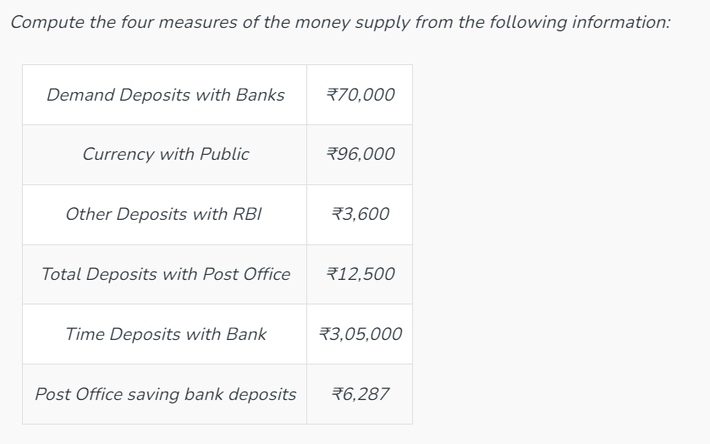
Review Question

Slide 18
Solution
The four measures of money supply are M₁, M₂, M₃, and M₄.
M₁ = Currency and coins with public + Demand deposits of commercial banks + Other deposits with Reserve Bank of India
M₁ = 96,000 + 70,000 + 3,600
= ₹1,69,600
M₂ = M₁ + Savings Deposits with Post Office Saving Bank
M₂ = 1,69,600 + 6,287
= ₹1,75,887
M₃ = M₁ + Time Deposits with Banks
M₃ = 1,69,600 + 3,05,000
= ₹4,74,600
M₄ = M₃ + Total Deposits with Post Office Saving Bank
M₄ = 4,74,600 + 12,500
= ₹4,87,100

Slide 19
What are Banks?
Banks are financial institutions that perform deposit and lending functions. There are various types of banks in India and each is responsible for performing different functions.
The bank takes deposits at a lower rate from the public called the deposit rate and lends money at a higher rate called the lending rate.
Notes:
Banks are financial institutions that offer a range of services, including accepting deposits, providing loans and credit, facilitating payments and transactions, offering investment services, and ensuring safety and security for customers' money. They play a vital role in the economy by helping individuals and businesses manage their finances, grow their wealth, and conduct financial transactions efficiently. Through various products and services, banks contribute to economic growth, financial stability, and wealth creation in society.

Slide 20
Central Bank (RBI)
Central bank is an ‘apex’ body that controls, operates, regulates and directs the entire banking and monetary structure of the country.
It is known as the apex (supreme) body as it occupies the top most position in the monetary and baking system of the country.
All the financially developed countries have their own central bank. India’s central bank is the Reserve Bank of India (RBI).
RBI was established in April 1, 1935 under Reserve Bank of India Act, passed in 1934.
Notes:
An apex body that controls, operates, regulates, and directs a country’s banking and monetary structure is known as a Central Bank. As the functions of a central bank are peculiar, there is only one central bank in a country. Every financially developed country has its own central bank. For example, the central bank of the UK is the Bank of England, and India is the Reserve Bank of India (RBI). The Reserve Bank of India was established on April 1, 1935, under the Reserve Bank of India Act, 1934.

Slide 21
What is Minimum Reserve System?
In India, currencies are issued by the RBI with the backing of reserves comprised of gold and foreign exchange (foreign currencies). For the issue of currencies, the RBI follows Minimum Reserve System at present.
Under the Minimum Reserve System, the RBI has to keep a minimum reserve of Rs 200 crore comprising of gold coin and gold bullion and foreign currencies. Out of the total Rs 200 crores, Rs115 crore should be in the form of gold coins or gold bullion.

Slide 22
Functions of Central Bank
Currency Authority
Central bank has the sole authority for issue of currency in the country. In India, RBI has the sole right of issuing paper currency notes (except one-rupee notes and coins, which are issued by ministry of finance).
The one-rupee note bears the signature of finance secretary while other currency notes bear the signature of governor of RBI
Notes:
Currency regulator or bank of issue: Central banks possess the exclusive right to manufacture notes in an economy. All the central banks across the world are involved in issuing notes to the economy.
This is one of the most important functions of the central bank in an economy and due to this the central bank is also known as the bank of issue.
Earlier all the banks were allowed to publish their own notes which resulted in a disorganised economy. To avoid this situation the government around the world authorised the central banks to function as the issuer of currency, which resulted in uniformity in circulation and balanced supply of money in the economy.
The "I promise to pay" clause on banknotes is a historical artifact from the time when banknotes were directly linked to a specific amount of gold or silver held by the issuing authority, typically a central bank or a commercial bank. This clause essentially represents a promise by the issuing authority to exchange the banknote for its equivalent value in gold or silver upon demand by the holder.
However, with the evolution of modern monetary systems, most countries have moved away from the gold standard and adopted fiat money, where the value of the currency is not directly backed by a physical commodity like gold or silver. Despite this shift, the "I promise to pay" clause has been retained on banknotes for legal and historical reasons.
In the context of fiat money, the promise to pay is interpreted more symbolically, representing the issuing authority's commitment to maintain the value and stability of the currency. It signifies the trust and confidence that individuals and businesses place in the currency and the issuing authority.
Here's an example to illustrate the concept:
Let's say you have a 100 rupee note issued by the Reserve Bank of India (RBI) with the "I promise to pay" clause printed on it. This clause indicates that the RBI pledges to exchange the 100 rupee note for goods, services, or other assets of equivalent value upon demand by the holder.
However, in reality, if you were to present the 100 rupee note to the RBI and demand payment, the RBI would not exchange it for gold or silver. Instead, the RBI would honor its commitment by accepting the note as legal tender and providing you with goods or services worth 100 rupees, or by exchanging it for other forms of currency if necessary.
In summary, while the "I promise to pay" clause on banknotes may no longer represent a direct convertibility into gold or silver, it symbolizes the issuer's commitment to uphold the value and acceptability of the currency in economic transactions.
The absence of the "I promise to pay" clause on the one rupee note in India is due to historical and practical reasons. Here are some factors contributing to this:
Cost-effectiveness: The one rupee note is the lowest denomination of currency in India, and its production cost is higher than its face value. Printing the "I promise to pay" clause on such low-denomination notes would be economically inefficient, as it would add to the printing costs without significant practical benefit.

Slide 23
Functions of Central Bank
II. Banker to the government
The Reserve Bank of India acts as a banker, agent and a financial advisor to the central government and all the state governments.
As a banker, it carries out all banking business of the government
It maintains a current account for keeping their cash balances.
It accepts receipts and make payments for the government and carries out exchange, remittance and other banking operations.
It also gives loans and advances to the government for temporary period. The government borrows money by selling treasury bills to the central bank.
Notes:
Bank to the government: One of the important functions of the central bank is to act as the bank to the government. The central bank accepts deposits and issues funds to the government. It is also involved in making and receiving payments for the government. Central banks also offer short term loans to the government in order to recover from bad phases in the economy.
In addition to being the bank to the government, it acts as an advisor and agent of the government by providing advice to the government in areas of economic policy, capital market, money market and loans from the government.
In addition to that, the central bank is instrumental in formulation of monetary and fiscal policies that help in regulation of money in the market and controlling inflation.

Slide 24
Functions of Central Bank
III. Banker’s bank and supervisor
There are a number of commercial banks in a country. There should be some agency to regulate and supervise their proper functioning.
Being the apex bank, the central bank (RBI) act as the banker to the other banks.
As the banker to banks, the central bank function in three capacities:
Custodian of cash reserves
Lender of the last resort
Clearing House
Notes:
Custodian of Cash reserves: It is a practice of the commercial banks of a country to keep a part of their cash balances in the form of deposits with the central bank. The commercial banks can draw that balance when the requirement for cash is high and pay back the same when there is less requirement of cash.
It is for this reason that the central bank is regarded as the banker’s bank. Central bank also plays an important role in the credit creation policy of commercial banks.
Custodian of International currency: An important function of the central bank is to maintain a minimum balance of foreign currency. The purpose of maintaining such a balance is to manage sudden or emergency requirements of foreign reserves and also to overcome any adverse deficits of balance of payments.
Lender of last resort: The central bank acts as a lender of last resort by providing money to its member banks in times of cash crunch. It performs this function by providing loans against securities, treasury bills and also by rediscounting bills.
This is regarded as one of the most crucial functions of the central bank wherein it helps in protecting the financial structure of the economy from collapsing.
Clearing house for transfer and settlement: Central bank acts as a clearing house of the commercial banks and helps in settling of mutual indebtedness of the commercial banks. In a clearing house, the representatives of different banks meet and settle the inter bank payments.
Lender of the last resort
When commercial banks fail to meet their financial requirements from other sources, i.e. in case of a financial emergency, they approach the central bank to give loans and advances as lender of last resort.
Central bank assists these banks through discounting of approved securities and bill of exchange
As central bank holds the cash reserves of all the commercial banks, it becomes easier and more convenient for it to act as their clearing house.
All commercial banks have their accounts with the central banks.
Therefore, the central bank can easily settle claims of various commercial banks against each other, by making debit and credit entries in their account.

Slide 25
Central Bank: Managing Foreign Exchange Reserves
The central bank keeps and manages the foreign exchange reserves of the country.
Funds coming from and going out to foreign countries are channelled through the central bank.
The central banks in most countries maintain both gold and foreign currencies as reserves against note issue and also meet adverse balance of payments.
Notes:
The Reserve Bank of India (RBI) manages foreign exchange reserves to ensure stability in the exchange rate, support international trade and investment, and maintain confidence in the Indian rupee. Here's how RBI manages foreign exchange reserves, along with an example:
Intervention in Foreign Exchange Markets: RBI actively participates in the foreign exchange market by buying and selling foreign currencies to influence the value of the Indian rupee relative to other currencies. When the rupee depreciates too rapidly, RBI may sell foreign currencies from its reserves to buy rupees, thereby increasing the demand for rupees and stabilizing its value. Conversely, when the rupee appreciates excessively, RBI may purchase foreign currencies to sell rupees, dampening its value.
Example: Suppose there is a sudden surge in demand for the US dollar, causing the Indian rupee to depreciate rapidly. In response, RBI may intervene by selling US dollars from its foreign exchange reserves and buying rupees. By increasing the supply of US dollars and reducing the supply of rupees in the foreign exchange market, RBI aims to stabilize the exchange rate and prevent excessive depreciation of the rupee.
2. Diversification of Reserves: RBI diversifies its foreign exchange reserves across different currencies and assets to minimize risks and optimize returns. It may hold reserves in major currencies such as the US dollar, euro, Japanese yen, and British pound, as well as in gold and other liquid assets. Diversification helps mitigate currency-specific risks and provides flexibility in managing the reserves portfolio.
Example: RBI may decide to allocate a certain percentage of its foreign exchange reserves to invest in US Treasury securities, which are considered safe and highly liquid assets. By diversifying its holdings across different currencies and asset classes, RBI aims to preserve the value of its reserves while generating returns.
3. Policy Coordination and Collaboration: RBI collaborates with the Government of India and other relevant authorities to formulate and implement policies related to foreign exchange management. It coordinates with the Ministry of Finance, Securities and Exchange Board of India (SEBI), and other stakeholders to ensure consistency in policy objectives and effective implementation of regulations.
Example: RBI may work closely with the Ministry of Finance to develop regulations governing capital flows, foreign investment, and exchange rate management. By aligning monetary and fiscal policies, RBI aims to maintain stability in the foreign exchange market and support economic growth and development.
Overall, RBI manages foreign exchange reserves through active intervention in the foreign exchange market, diversification of reserves, and policy coordination with relevant stakeholders. These measures help ensure stability in the exchange rate, safeguard the value of the Indian rupee, and support the country's economic objectives.

Slide 26
Central Bank: Controller of Money Supply and Credit
The Reserve Bank of India (RBI) is empowered to regulate the money supply in the economy through its ‘monetary policy’.
Monetary policy is a policy adopted by the central bank of an economy in the direction of credit control or money supply.
As RBI has the sole monopoly in currency issue, it can control credit and supply of money.
For this, RBI makes use of various instruments of monetary supply
Notes:
RBI has the sole monopoly in the issuance of currency through which it can control money supply and credit whenever there is economic fluctuation. To do so, the Reserve Bank of India uses the following methods of credit control:
A. Repo (Repurchase) Rate: The rate at which a country’s central bank (in the case of India, RBI) lends money to commercial banks to meet their short-term financial needs is known as the repo rate. The central bank advances loans to commercial banks against approved securities or eligible bills of exchange. An increase in the repo rate increases the cost of borrowing from the central bank, which ultimately forces the commercial banks to increase their lending rates, discouraging the borrowers from taking loans from the commercial banks and vice-versa.
Reverse Repo Rate: It is the exact opposite of repo rate. It means that Reverse Repo Rate is the rate at which the Reserve Bank of India borrows money from commercial banks. RBI borrows money from commercial banks when it feel that there is excess money supply in the banking system of the country. Besides, banks also happily lends money to the central bank as there money is in safe hands and they also get a good interest rate. An increase in the reverse repo rate induces the commercial banks to transfer more money to RBI because of the attractive interest rates.
B. Bank Rate(or Discount Rate): The rate at which a country’s central bank (in the case of India, RBI) lends money to commercial banks to meet their long-term financial needs is known as the bank rate. Bank Rate has the same effect on credit as that of Repo Rate. Simply put, an increase in the Bank Rate increases the cost of borrowing from the central bank, which ultimately increases the lending rates by commercial banks discouraging the borrowers from taking loans.
C. Open Market Operations: OMO or Open Market Operations means buying and selling of government securities by the Central Bank from/to the commercial banks and the general public, respectively. The Reserve Bank of India has the authority to sell or purchase government securities and treasury bills, whether bought or sold to the banks or the general public. It is because the amount given or received will ultimately be deposited in or transferred from some bank. By selling securities, the central bank reduces commercial banks’ reserves, which has an adverse impact on their ability to create credit, ultimately decreasing the money supply in the economy. By purchasing securities, the central bank increases the reserves and raises the ability of the banks to give credit.
The four essential conditions required for the success of Open Market Operations are as follows:
A well-developed and organized security market should exist.
The value of government securities should not show frequent fluctuations.
In order to influence the money supply in the economy, the central bank should hold adequate securities.
Ultimately, the sale and purchase of securities should have an impact on the reserves of commercial banks.
D. Legal Reserve Requirements (Variable Reserve Ratio Method): According to the requirements of Legal reserve, commercial banks have the obligation to maintain reserves. It is a quick and direct method used by the central bank to control the credit-creating power of commercial banks. Commercial banks have to maintain reserves on two accounts; viz., Cash Reserve Ratio (CRR) and Statutory Liquidity Ratio (SLR).
Cash Reserve Ratio (CRR): It is the minimum percentage of the net demand and time liabilities that commercial banks have to keep with the central bank. By changing the cash reserve ratio, the central bank affects the ability of commercial banks to create credit. For example, if there is an increase in the cash reserve ratio, it reduces the excess reserves of commercial banks and limits their credit-creating power.
Statutory Liquidity Ratio (SLR): It is the minimum percentage of net demand and time liabilities that commercial banks have to maintain with themselves. Commercial banks have to maintain SLR in the form of designated liquid assets, like excess reserves, current account balances with other banks, or unencumbered, government and other approved securities. By changing SLR, the central bank affects the freedom of commercial banks to borrow against the government securities or sell them to the Central Bank. It means that, if there is an increase in the statutory liquidity ratio, it reduces the ability of the banks to give credit and vice-versa.
Simply put, by making changes in the Cash Reserve Ratio and Statutory Liquidity Ratio, the Reserve Bank of India can influence the credit creation power of commercial banks.
Unencumbered Securities are those securities which do not act as security for loans from Central Bank.
Approved Securities are the securities for which the government guarantees repayment.
E. Margin Requirements: The difference between the loan amount and the market value of the security offered by the borrower against the loan is known as the margin requirement. It means that if the central bank fixes the margin as 30%, then the commercial banks are allowed to give a loan up to 70% of the value of the security. Margin is essential because if a bank gives a loan equal to the full value of the security, then it will suffer a loss if the price of a security falls. Hence, by making changes in the margin requirements, the central bank (RBI) can alter the loan amount made against the securities by the banks.
If there is an increase in the margin, it reduces the borrowing capacity and money supply in the economy. If there is a reduction in the margin, it encourages people to borrow more. The central bank may prescribe different margin requirements for different types of borrowers against the security of the same commodity.
5. Custodian of Foreign Exchange Reserves
The central bank (RBI) also acts as the custodian of the country’s foreign exchange reserves and gold stock. By acting as the custodian of foreign exchange reserves, the central bank can exercise reasonable control over foreign exchange. The regulations of foreign exchange state that all foreign exchange transactions must be routed through the central bank (RBI).
Two major objectives behind the centralisation of foreign exchange transactions with the Reserve Bank are:
It helps the bank stabilize the external value of the currency.
It helps the bank in pursuing a coordinated policy towards the country’s balance of payment situation.
Other Instruments of Credit Control
1. Moral Suasion: In order to get the commercial banks to act according to the policy, the Central Bank (RBI) applies a combination of persuasion and pressure on them, which is known as moral suasion. The central bank exercises moral suasion through letters, discussions, hints, and speeches to banks. The Reserve Bank of India announces its policy position frequently and urges commercial banks to cooperate in the implementation of these credit policies. The central bank can use moral suasion for both quantitative as well as qualitative credit control. In general, the central bank successfully convinces the banks, as it acts as their lender of last resort. However, if the commercial banks do not follow the advice or request of the central bank, no punitive action is taken against them.
2. Selective Credit Controls: Under this instrument of credit control the Reserve Bank of India directs other banks regarding giving or not giving credit to specific sectors for certain purposes. The method of selective credit control can be applied in positive as well as negative manners. In a positive manner, it means using the measures in channelising credit to the priority sectors, which include exports, agriculture, small-scale industries, etc. In a negative manner, it means using measures in restricting the flow of credit to specific sectors.

Slide 27
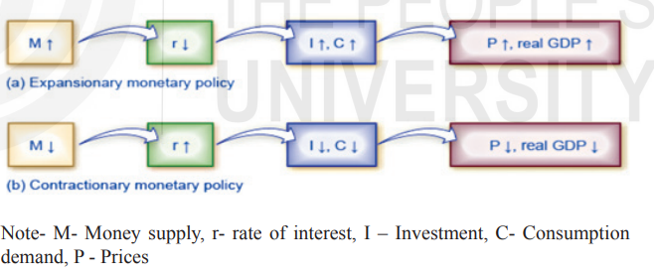
What is Monetary Policy?
Central banks use monetary policy to manage the supply of money in a country’s economy. With monetary policy, a central bank increases or decreases the amount of currency and credit in circulation, in a continuing effort to keep inflation, growth and employment on track.
Notes:
Monetary policy refers to the actions undertaken by a country's central bank to control the money supply and achieve specific macroeconomic objectives. The primary goal of monetary policy is typically to achieve price stability, low inflation, and promote sustainable economic growth. Central banks implement monetary policy through various tools and strategies. In India, The Reserve Bank of India (RBI) is solely responsible for monetary policy that decides the supply of money in the Indian economy.
The main objective of the monetary policy is to enable price stability, controlled expansion of bank credit and money supply, increase the productivity of fixed investments and equitable distribution of credit to all sectors of the economy.
The monetary policy response depends on the economic state of affairs of the economy. Based on which, the monetary policy may be categorized in one of two ways: expansionary monetary policy or contractionary monetary policy.
Expansionary Monetary Policy: This is known as loose monetary policy, expansionary policy increases the supply of money and credit to generate economic growth. A central bank may deploy an expansionist monetary policy to reduce unemployment and boost growth and investment during hard economic times. The overall goal of any expansionary policy is to encourage spending and borrowing. This is done by reducing the interest rate, subsequently providing easier and cheaper loans to the borrowers. According to economic theory, more money available to individuals and businesses at lower cost will result in the increased purchase of goods and services, thus stimulating growth.
b) Contractionary Monetary Policy: Tight or contractionary monetary policy is used to prevent inflation due to economy growing too fast (over-heating). It aims at reducing the money supply, raising the interest rates and therefore, discouraging borrowing in the economy. Business investment will decline because it is less attractive for firms to borrow money. In addition, higher interest rates will also discourage consumer borrowing for big-ticket items like houses and cars.

Slide 28
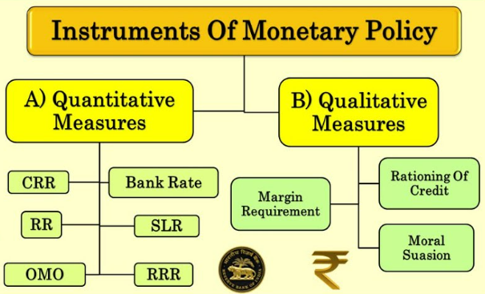
Tools of Monetary Policy
Notes:
It includes quantitative and qualitative measures:
1. Quantitative Measures
The quantitative measures regulate the total quantity of credit in the economy. Such measures affect the economy as a whole and are non-discriminatory in character. It includes the following:
a. Bank rate
Bank rate or discount rate means the same in case of credit control by the central bank.
The rate at which the central bank of a country lends money to the commercial banks to meet their long term needs.
Let’s discuss the two cases to control credit in the economy:
If there is inflation or extra money supply in the economy, it implies excess demand for money in the economy. In such a case, the bank rate is increased which further increases the lending rate of commercial banks. It makes the credit costlier, demand for credit decreases, less money will go to the economy, purchasing power is reduced, aggregate demand in the economy falls and excess demand is corrected.
If there is deflation in the economy or less money supply, it implies deficient demand for money in the economy. In such a case, the bank rate is reduced, it decreases the lending rate by commercial banks, it makes the credit cheaper, demand for credit increases. More money flows to the economy, purchasing power increases, aggregate demand increases, and deficient demand is corrected.
b. Repo rate
The rate at which the central bank of a country lends money to the commercial bank to meet their short term need.
Let’s discuss the two cases to control credit in the economy:
If there is inflation or extra money supply in the economy, it implies excess demand for money in the economy. In such a case, the central bank will increase the repo rate which will make borrowing by commercial banks costly. So, when the repo rate is increased, banks are also forced to raise their lending rate. It made the credit costlier, demand for credit reduces, less money goes to the economy. The purchasing power is reduced, aggregate demand falls and excess demand is corrected.
If there is deflation in the economy or less money supply, it implies deficient demand for money in the economy. In such a case, the repo rate is reduced, it makes credit cheaper for commercial banks. In turn, commercial banks reduced lending rates for the borrowers, demand for credit increases. More money flows to the economy, purchasing power increases, aggregate demand increases, and deficient demand is corrected.
c. Reverse Repo Rate
The rate at which commercial banks lends money to the central bank is called the reverse repo rate.
If there is inflation or extra money supply in the economy, it implies excess demand for money in the economy. In such a case, the reverse repo rate is increased it encourages commercial banks to park their surplus funds with the central bank. This has a negative effect on the lending capacity of the commercial banks. Demand for credit will reduce, less money will go to the economy, aggregate demand falls and excess demand is corrected.
If there is deflation in the economy or less money supply in the economy, it implies deficient demand for money in the economy. In such a case, the reverse repo rate is reduced it discourages the commercial banks to park their surplus funds with the central bank. Hence, lowering the reverse repo rate has a positive effect on the lending capacity of the commercial banks which raises the demand for borrowing from commercial banks, more money flows to the economy, purchasing power increases, aggregate demand increases, and deficient demand is corrected.
d. Open Market Operation
It refers to the purchase and sale of government securities in the open market (public and commercial banks) by the central bank.
If there is inflation or extra money supply in the economy, it implies excess demand for money in the economy. In such a case, government securities are sold by the central bank in the open market. The central bank withdraws additional purchasing power. There will be a contraction of credit, less money flows in the economy, purchasing power in the economy reduces, aggregate demand falls and excess demand gets corrected.
If there is deflation in the economy or less money supply in the economy, it implies deficient demand for money in the economy. In such a case, by purchasing the government securities, the central bank injects additional purchasing power in the system which expands credit. More money flows in the economy, purchasing power increases, aggregate demand rises and deficient demand is corrected.
e. Legal Reserve Ratio
LRR or variable reserve ratio is that fraction of the deposits of commercial banks, which is legally compulsory for them to maintain on account of cash reserve ratio and statutory liquidity ratio.
Cash Reserve Ratio
It is also known by the minimum reserve ratio. CRR is the minimum percentage of deposits of commercial banks (Net demand and time liabilities) which is kept in the form of cash with the central bank.
If there is inflation or extra money supply in the economy, it implies excess demand for money in the economy. In such a case, CRR is increased to control excess demand. The central banks withdraw additional purchasing power, there will be a contraction of credit, less money will flow in the economy. The purchasing power in the economy reduces, aggregate demand falls and the excess demand is corrected.
If there is deflation in the economy or less money supply in the economy, it implies deficient demand for money in the economy. In such a case, CRR is decreased to control the deficient demand. The central banks injects additional purchasing power in the economy which expands credit demand. Money flows in the economy, purchasing power increases, aggregate demand rises and deficient demand is corrected.
Statutory Liquidity Ratio
SLR is the minimum percentage of deposits of commercial banks (Net demand and time liabilities) which every bank is required to maintain with itself in the form of liquid assets like current account balances.
If there is inflation or extra money supply in the economy, it implies excess demand for money in the economy. In such a case, SLR is increased to control excess demand. The central bank withdraws additional purchasing power in the economy. There will be contraction of credit, less money will flow in the economy, purchasing power in the economy falls, aggregate demand decreases and excess demand is corrected.
If there is deflation in the economy or less money supply in the economy, it implies deficient demand for money in the economy. In such a case, SLR is decreased to control of deficient demand. The central bank injects additional purchasing power in the economy which expands the demand for credit. Money flows in the economy, purchasing power increases, aggregate demand increases, and deficient demand is corrected.
2. Qualitative measures
It refers to selective credit control that focuses on allocation of credit in the different sectors. It includes the following:
a. Margin requirement
A margin is a difference between the market value of the securities offered by the borrowers against the loan and the amount of loan granted.
Margin requirement also means the discount fixed by the central bank on the assets which are kept as securities to the commercial banks.
For example, margin requirement is 20%, then bank is allowed to give loan only upto 80% of the value of the securities.
If there is inflation or extra money supply in the economy, it implies excess demand for money in the economy. In such a case, the margin requirement is increased, to correct excess demand. The central bank withdraws additional purchasing power, there will be a contraction of credit, less money will flow in the economy. The purchasing power in the economy falls, aggregate demand decreases, and excess demand is corrected.
If there is deflation in the economy or less money supply in the economy, it implies deficient demand for money in the economy. In such a case, the margin requirement is reduced to correct deficient demand. The central bank injects additional purchasing power in the system which expands credit, more money flows in the economy. The purchasing power in the economy increases, aggregate demand increases, and deficient demand is corrected.
b. Moral Suasion
Moral suasion implies persuasion, request, informal suggestion, advice, and appeal by the central banks to commercial banks to cooperate with the general monetary policy of the central bank.
c. Rationing of Credit
Rationing of credit by the Reserve Bank of India (RBI) refers to the practice of imposing limits or quotas on the amount of credit that banks can extend to borrowers in certain sectors or for specific purposes. It involves regulating the availability of credit in the economy by setting restrictions on lending activities to ensure that credit is allocated efficiently and in line with the central bank's monetary policy objectives.
The RBI may use rationing of credit as a qualitative tool to:
Control inflation: By limiting the amount of credit available for certain activities or sectors that are contributing to inflationary pressures, the RBI can help to moderate demand and control rising prices.
Direct credit to priority sectors: The RBI may allocate credit quotas to prioritize lending to specific sectors deemed critical for economic development, such as agriculture, small-scale industries, or exports. This ensures that credit is channeled to areas that have a significant impact on overall economic growth and social welfare.
Manage financial stability: Rationing of credit can also be used to prevent excessive risk-taking or speculative behavior in financial markets by imposing constraints on lending activities that may pose systemic risks or lead to financial instability.
Overall, rationing of credit allows the RBI to influence the availability and distribution of credit in the economy, thereby supporting its broader monetary policy objectives of price stability, economic growth, and financial stability. It helps ensure that credit is allocated efficiently and in line with the central bank's policy priorities.

Slide 29
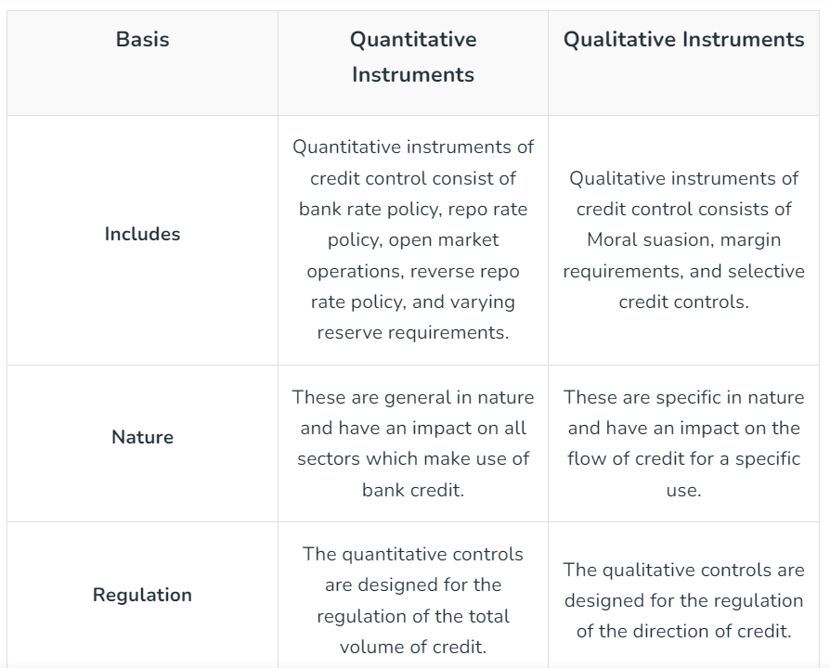
Quantitative Measure vs Qualitative Measures
Another name for quantitative instruments is Traditional Methods of Control.
Another name for qualitative instruments is Selective Methods of Control.

Slide 30
Review Question
Question: When does RBI use the contractionary monetary policy?
Before an economic recession
During an economic recession
Before an inflation period
During an inflation period
Answer: During an inflation period
Notes:
RBI (Reserve Bank of India) uses contractionary monetary policy during an inflation period.
During times of rising inflation, when prices of goods and services are increasing at a rapid pace, the RBI may implement contractionary monetary policy measures to control inflationary pressures. Contractionary monetary policy aims to reduce the money supply in the economy, which in turn helps to decrease aggregate demand and moderate inflationary pressures.
Some common tools used in contractionary monetary policy include:
Increasing the Cash Reserve Ratio (CRR): This mandates banks to hold a higher proportion of their deposits as reserves, reducing the amount of funds available for lending and spending.
Increasing the Repo Rate: This is the rate at which the RBI lends money to commercial banks. By increasing the repo rate, the cost of borrowing for banks rises, leading to higher lending rates for consumers and businesses, which can dampen spending and investment.
Open Market Operations (OMO): Selling government securities in the open market reduces the reserves available to banks, thereby tightening liquidity in the financial system.
By implementing these measures, the RBI aims to moderate economic activity and bring down inflationary pressures to ensure price stability and sustainable economic growth.

Slide 31
Review Question
Question: An increase in Bank Rate generally indicates that
a. Market rate of interest is likely to fall.
b. Central bank is no longer making loans to commercial banks.
c. Central bank is following an easy money policy.
d. Central bank is following a tight money policy.
Answer:
Notes:
The Bank Rate is the rate at which the central bank (such as the Reserve Bank of India) lends money to commercial banks. When the central bank increases the Bank Rate, it becomes more expensive for commercial banks to borrow funds from the central bank. This leads to higher interest rates in the broader financial market and reduces the availability of credit in the economy. As a result, borrowing becomes more expensive, which discourages borrowing and spending, leading to a tighter monetary policy stance aimed at controlling inflation or cooling down an overheating economy.

Slide 32
Review Question
Question: Under which qualitative tool, RBI fixes maximum limit to loan and advances that can be made, above which the commercial banks cannot exceed?
Rationing of credit
Margin requirement
Loan-Value ratio
Moral Suasion
Answer: a) Rationing of credit.
Notes:
Under the qualitative tool known as "Rationing of credit," RBI fixes a maximum limit to loans and advances that can be made by commercial banks, above which the banks cannot exceed. Rationing of credit involves setting specific quotas or limits on the amount of credit that banks can extend to borrowers in certain sectors or for particular purposes. This helps the central bank control the flow of credit in the economy and steer lending towards priority sectors or activities while ensuring financial stability.

Slide 33
Review Question
Question: When RBI reduces Statutory Liquidity Ratio , which of the following is likely to happen?
India’s GDP growth rate increases drastically.
Foreign Institutional Investors may bring more capital in to our country.
Scheduled Commercial Banks may cut their lending rates.
It may drastically reduce the liquidity to the banking system.
Answer: c
Notes:
When RBI reduces the Statutory Liquidity Ratio (SLR), it lowers the percentage of deposits that banks are required to hold in the form of government securities or other liquid assets. This action is typically undertaken to increase the liquidity available to banks for lending purposes and stimulate economic activity.
Given this context, the most likely outcome is:
Scheduled Commercial Banks may cut their lending rates.
When banks have more liquidity available for lending due to a reduction in the SLR, they may choose to lower their lending rates to attract borrowers and stimulate investment and consumption in the economy. Lower lending rates can encourage businesses and individuals to borrow for investment and consumption purposes, thereby potentially boosting economic growth.
The other options are less directly related to the reduction of the SLR:
India’s GDP growth rate increases drastically: While a reduction in the SLR can contribute to economic growth by increasing liquidity, it is unlikely to cause GDP growth to increase drastically on its own.
Foreign Institutional Investors may bring more capital into our country: While a reduction in the SLR could potentially lead to increased liquidity and a more favorable investment environment, the decision of foreign institutional investors to bring capital into the country depends on a variety of factors beyond just the SLR.
It may drastically reduce the liquidity to the banking system: The reduction in the SLR actually increases liquidity in the banking system by freeing up funds that were previously held as reserves. Therefore, it is unlikely to drastically reduce liquidity.

Slide 34
Review Question
Question: Reverse Repo Rate is a tool used by RBI to?
Absorb liquidity
Inject liquidity
To keep liquidity at one level
None of these
Answer: a) Absorb liquidity
Notes:
Reverse Repo Rate: The rate at which the RBI is willing to borrow from the commercial banks is called reverse repo rate. If the RBI increases the reverse repo rate, it means that the RBI is willing to offer lucrative interest rate to commercial banks to park their money with the RBI. This results in a reduction in the amount of money available for the bank’s customers as banks prefer to park their money with the RBI as it involves higher safety. This naturally leads to a higher rate of interest which the banks will demand from their customers for lending money to them, thereby causing reduction in liquidity.

Slide 35
Commercial Banks
Commercial banks accept deposits from individuals, businesses, and governments.
They provide loans and credit to borrowers, including personal loans, business loans, and mortgages.
Commercial banks offer various banking services such as payment services, investment banking, foreign exchange services, and wealth management.
They are regulated by central banks and financial regulators to ensure compliance with banking laws and regulations, and to maintain the stability of the financial system.

Slide 36
Current Account Deposits or Demand Deposits
These deposits refer to those deposits which are repayable by the bank on demand.
Such deposits are generally maintained by businessmen with the intention of making transactions with such deposits.
They can be drawn upon by a cheque without any restriction.
Banks do not pay any interest on these accounts, rather banks impose service charges for running these accounts.
Notes:
In the context of a commercial bank, the term "current account" refers to a type of deposit account that allows customers to deposit and withdraw funds freely without any restrictions on the number or frequency of transactions. It is also known as a checking account in some countries.
Here are some key features of a current account with a commercial bank:
Flexibility: Current accounts offer flexibility in terms of deposits and withdrawals. Customers can deposit funds into their account at any time and withdraw funds as needed, either through checks, ATM withdrawals, or electronic transfers.
No Interest: Unlike savings accounts, current accounts typically do not earn any interest on the deposited funds. Instead, customers may incur fees or charges for certain services, such as overdrafts or insufficient funds.
Transactional Account: Current accounts are primarily used for conducting day-to-day financial transactions, such as paying bills, making purchases, or receiving salary payments. They are ideal for individuals or businesses that have frequent financial transactions.
Overdraft Facility: Many current accounts come with an overdraft facility, which allows customers to withdraw more funds than they have available in their account, up to a specified limit. However, overdrafts often incur fees or interest charges.
Access to Additional Services: Current account holders may also have access to additional banking services, such as debit cards, online banking, mobile banking, and standing orders for regular payments.
Overall, current accounts play a vital role in providing individuals and businesses with a convenient and flexible way to manage their day-to-day financial transactions. They serve as a central hub for receiving income, making payments, and accessing various banking services.

Slide 37
Saving Deposits
These deposits combine features of both current account deposits and fixed deposits.
The depositors are given cheque facility to withdraw money from their account. But, some restrictions are imposed on the number and amount of withdrawals, in order to discourage frequent use of saving deposits.
They carry a rate of interest which is less than interest on fixed deposits.
Notes:
A savings account with a commercial bank is a type of deposit account that is designed to help individuals save money while earning interest on their deposits. Here are some key features of a savings account with a commercial bank:
Interest Earnings: Unlike current accounts, savings accounts typically earn interest on the deposited funds. The interest rate may vary depending on the bank and prevailing market conditions. Interest is usually calculated on a daily or monthly basis and credited to the account periodically.
Limited Transactions: Savings accounts may have limitations on the number of withdrawals or transfers allowed per month. This restriction encourages account holders to save their funds rather than use them for day-to-day transactions. Exceeding the permitted number of transactions may incur fees or penalties.
Minimum Balance Requirement: Some savings accounts may require a minimum balance to be maintained in the account to avoid fees or to qualify for a higher interest rate. The minimum balance requirement varies depending on the bank and the type of savings account.
Security and Convenience: Savings accounts offer a secure place to store funds while providing easy access to money when needed. Account holders can deposit or withdraw funds through various channels, including branches, ATMs, online banking, and mobile banking.
Goal-Oriented Saving: Many people use savings accounts to save money for specific goals, such as emergencies, vacations, education, or buying a home. Some banks offer specialized savings accounts tailored to specific savings goals, with features such as automatic transfers and goal tracking.
Overall, savings accounts serve as a simple and effective way for individuals to save money, earn interest on their deposits, and achieve their financial goals. They provide a safe and convenient means of storing funds while offering the potential for modest interest earnings over time.

Slide 38
Fixed Deposits or Time Deposits
It refers to those deposits, in which the amount is deposited with the bank for a fixed period of time.
Such deposits do not enjoy chequable facility.
These deposits carry a high rate of interest.
Notes:
A fixed deposit (FD) with a commercial bank is a type of savings instrument where a customer deposits a sum of money with the bank for a specified period at a predetermined interest rate. Here are the key features of a fixed deposit with a commercial bank:
Fixed Term: Fixed deposits have a fixed maturity period, ranging from a few months to several years, chosen by the depositor at the time of opening the FD account. Once the deposit is made, the funds are locked in for the specified term, and premature withdrawal may incur penalties.
Guaranteed Returns: Fixed deposits offer a guaranteed rate of return, known as the fixed deposit interest rate, which is determined by the bank at the time of opening the FD. The interest rate remains constant throughout the tenure of the deposit, providing certainty of returns to the depositor.
Interest Payment Frequency: The interest earned on fixed deposits can be paid out to the depositor at different frequencies, such as monthly, quarterly, semi-annually, annually, or at maturity, depending on the depositor's preference. Some FDs also offer the option of reinvesting the interest to compound earnings.
Safety and Security: Fixed deposits with commercial banks are considered a safe and secure investment option as they are backed by the bank's reputation and regulatory safeguards. The principal amount invested in the FD is generally protected, and the interest earned is assured.
Penalty for Premature Withdrawal: If a depositor needs to withdraw funds from a fixed deposit before the maturity date, they may incur a penalty or forfeit a portion of the interest earned. The penalty amount varies depending on the bank's terms and conditions and the remaining tenure of the FD.
Flexible Deposit Amount: Depositors can choose the amount they wish to invest in a fixed deposit, with some banks having minimum deposit requirements. This flexibility allows individuals to invest according to their financial goals and liquidity needs.

Slide 39
Credit Creation by Commercial Banks
The money multiplier or credit creation is the amount of money that banks generate with each rupee of reserves.
It is an important function of commercial banks.
Through the process of money creation, commercial banks are able to create credit, which is in far excess of initial deposits.

Slide 40
Credit Creation by Commercial Banks
The capacity of banks to create money or credit depends on two factors:
Amount of initial fresh deposits or primary deposits
Legal Reserve Ratio (LRR)
It is fixed by the Central Bank of the country and it is the minimum ratio of deposits legally required to be kept by the banks.
Notes:
The banking structure is entirely based on the creation of credit. In simple words, credit means getting the power to purchase anything now and promise to pay it later in the future; the bank charges interest in case of non-fulfillment of the desired amount. Based on these credits, the bank uses a part or a fraction of its customer deposits to offer loans or lend money on credit to other individuals and businesses.
Money creation or credit creation is one of the most important activities of commercial banks. Because of credit creation, banks are able to create credit, which is in excess of the initial deposits.
This process is based on two assumptions and can be understood with the help of them:
The entire commercial banking system is considered as one unit and is termed as ‘Banks’.
All receipts and payments are routed through Banks, i.e., all payments are made through cheques, and receipts are deposited in banks.
Banks use the deposits held with them for giving loans. However, they cannot use the whole deposits for lending. It is legally compulsory for the banks to maintain a certain minimum fraction of their deposits as reserves. This fraction is called Legal Reserve Ration (LRR), which is fixed by the central bank.
Some basic terms used in Credit Creation
Primary Deposits: A deposit is considered a primary deposit when the bank accepts cash from its customer and deposits it under his name into his account. These deposits convert the currency money into deposit money.
Secondary or Derivative Deposits: A deposit is considered a secondary or derivative deposit when the bank grants loans to the borrower. Instead of giving cash, the amount is deposited under the borrower’s name into his account.
Excess Reserves: Every financial institution or bank is required to hold a certain amount of money as a reserve to ensure proper liquidity. However, when the cash held by the bank is above the reserve requirements set by the authority, it is said to be an excess reserve.
Credit Multiplier: Credit Multiplier refers to the ratio of change in secondary deposits due to the change in primary deposits.

Slide 41
Money Multiplier
Money multiplier (m) is the inverse of the Legal Reserve Requirement (LRR)
Money Multiplier = 1/LRR
m = 1/LRR
For example, with a legal reserve ratio of 20%, the money multiplier, m, will be calculated as:
m = 1/(1/5) = 5
Notes:
Money Multiplier
Money Multiplier can be stated as the phenomenon in which the creation of money is done in the form of credit creations in the economy. In other words, a money multiplier can be described as the influence a central bank plays over the money supply by modifying the required reserve rates.
Money Multiplier or Deposit Multiplier measures the amount of money that the banks are able to create in the form of deposits with every unit of money it keeps as reserves. The Money Multiplier plays a great role in the banking system of the economy as every time the government needs to kick-start the economy, the multiplier helps decide what proportion of stimulation should be applied and in what manner.
Formula
The money multiplier is expressed as:
Where ‘r’ is the Reserve Ratio or the Cash Reserve Ratio, and it can be described as the minimum ratio required to be maintained by commercial banks.
This figure is multiplied by the number of reserves to calculate the money supply's maximum potential amount.
For example, if the Reserve Ratio is 1/10 (10 percent) or the Money Multiplier is 10, Rs.100 can be multiplied by 10 to generate Rs.1000 in the money supply.
When the Reserve Ratio is 1/4 (25%) or the Money Multiplier is 4, the money supply is only Rs. 400.

Slide 42
Credit Creation by Commercial Banks
The process of money creation is based on two assumptions:
The entire commercial banking system is treated as ‘one unit’.
All monetary exchanges in an economy are routed through banks.

Slide 43
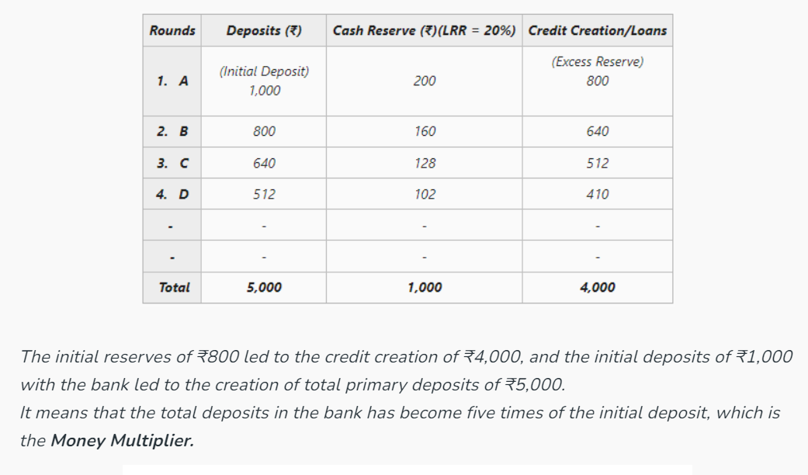
Credit Creation Example
Notes:
Let’s assume that the LRR (Legal Reserve Requirement) or Reserve Ratio is 20%.
‘A’ deposits ₹1,000 with the bank. The money deposited by ‘A’ will be the Initial Deposit. This means that the bank can keep only ₹200 (20% of ₹2000) as cash reserve and can lend the remaining ₹800.
In case the bank lends ₹800 to a borrower ‘B’, the amount will not be given in the form of cash. Instead, the bank will open an account under the name of ‘B’ and the amount will be credited to his account. The money spent by ‘B’ comes back into the bank in the form of deposit accounts of those who have received this payment. This will increase the demand deposit of banks by ₹800.
With the new deposit, the bank keeps 20% of ₹800 (i.e., ₹160) as cash revenue and lends the remaining ₹640 to another borrower ‘C’, which again comes back to the bank as a deposit when ‘C’ spends the money. This time, the demand deposit of the bank increases by ₹640.
Further with the new deposit, the bank keeps 20% of ₹640 (i.e., ₹128) as cash reserve, and lends the remaining ₹512 to borrower ‘D’, which again comes back to the bank as a deposit when ‘D’ spends the money. This time the demand deposit of the bank increases by ₹512.
This process of deposit creation continues till the total cash reserves become equal to the initial deposit i.e., ₹1,000.

Slide 44
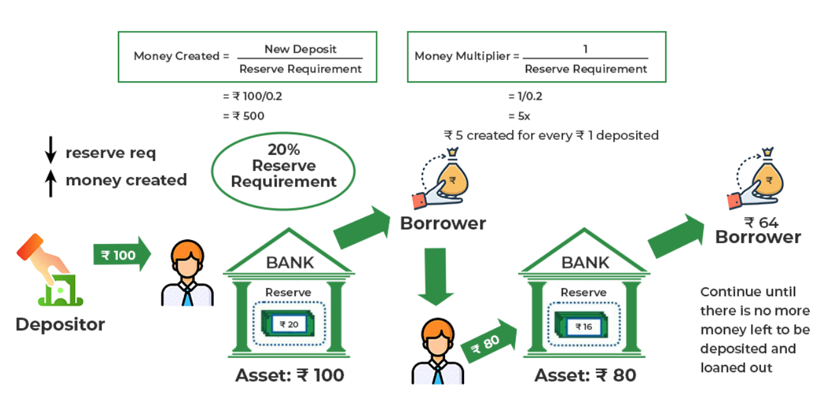
Credit Creation: Diagrammatic Representation

Slide 45
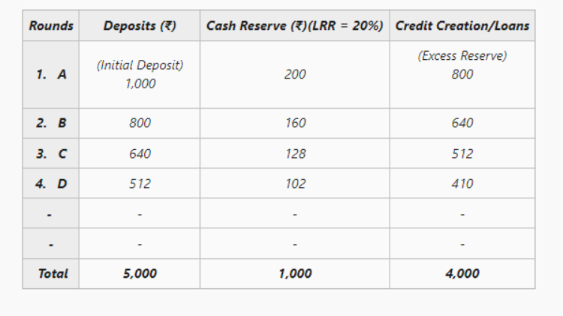
Review Question Question: Calculate the money multiplier from the given table.
Notes:
LRR or Reserve Ratio = 20%
Total Primary Deposits, i.e., ₹5,000
Total Cash Reserve, i.e., ₹1,000
Total Credit Creation, i.e., ₹4,000
= 5 Therefore, the value of Money Multiplier is 5.

Slide 46
Review Question
Question: Calculate the total deposits created if initial deposits is of 2,000 crores and LRR is 11.5%.
Answer: Money Multiplier= 1/LRR = 1/11.5% = 8.69
Initial deposits = 2,000 crores
Total Deposits = Initial Deposits * Money Multiplier
= 2,000 * 8.69
= 17, 380 crores

Slide 47
Review Question
Question: Which of the following is known as broad money?
a. M1
b. M2
c. M3
d. M4
Solution: M3
Notes:
M3 is known as "broad money" because it encompasses a wider range of financial assets than narrower measures of the money supply, such as M1 and M2. Broad money includes not only physical currency (like coins and notes) and demand deposits (included in M1 and M2) but also includes other types of deposits and financial instruments that are relatively liquid and can be quickly converted into spending power.
These additional components of M3 may include time deposits (such as certificates of deposit), savings deposits, and other near-money assets. By incorporating these broader measures of money, M3 provides a more comprehensive view of the overall liquidity and financial resources available within an economy.
As a result, policymakers and economists often use M3 as an indicator of the overall liquidity and financial health of an economy, as it captures a more extensive range of financial assets that could potentially be used for spending and investment purposes.

Slide 48
Review Question
Question: M1 does not include
Time deposits with the banking system
Currency in circulation
Demand deposits with the banking system
Other deposits with RBI
Solution: Time deposits with the banking system
Notes:
M1 does not include time deposits because time deposits are less liquid than the components included in M1. M1 represents the most liquid forms of money, readily available for transactions and spending. Time deposits, on the other hand, involve funds that are deposited with a bank for a specified period, during which they cannot be withdrawn without penalty or advance notice. M1 is also known as narrow money.

Slide 49
Review Question
Question: The money multiplier in an economy increases with which one of the following:
Increase in the cash reserve ratio
Increase in the banking habit of the people
Increase in the statutory liquidity
Increase in the population of the country
Solution: Increase in the banking habit of the people
Notes:
When people deposit more money into banks, it increases the reserves available to banks. As a result, banks can lend out more money, leading to an increase in the money supply through the money creation process. This increase in lending and subsequent money creation amplifies the impact of initial deposits, thereby increasing the money multiplier. So, an increase in the banking habit of the people leads to a higher money multiplier.

Slide 50
Review Question
Question: Money Supply is directly proportional to
Cash reserve ratio
Monetary base
currency deposit ratio
Statutory Liquidity Ratio
Answer: Monetary base
Notes:
Money Supply is directly proportional to the Monetary base and inversely proportional to the Cash Reserve Ratio and the Statutory Liquidity Ratio.
The Monetary base refers to the total amount of currency in circulation and the reserves held by the central bank. An increase in the monetary base directly increases the potential for the expansion of the money supply through the banking system.
The Cash Reserve Ratio (CRR) and the Statutory Liquidity Ratio (SLR) are regulatory requirements imposed by the central bank on commercial banks. Both ratios mandate a certain percentage of deposits to be held in reserve as cash or in specified liquid assets. An increase in either the CRR or the SLR reduces the amount of funds available for banks to lend out, constraining the expansion of the money supply.
The Currency Deposit Ratio is not directly related to the money supply. It measures the proportion of currency held by the public relative to deposits in banks but does not directly affect the money supply.

